Slide 1


Slide 2
The Evolution
In the early days , the World Wide Web consisted only of web sites. These were essentially information repositories containing static documents.
The flow of interesting information was one-way, from server to browser.
Most sites did not authenticate users, because there was no need.
Today, the majority of sites are highly functional and rely on two-way flow of information between the server and browser.
They support registration and login, financial transactions,search, and the authoring of content by users.
The content presented to users is generated dynamically.

Slide 3
Importance & Benefits Of Web Applications
HTTP, the core communications protocol used to access the World Wide Web, is lightweight and connectionless. This provides resilience in the event of communication errors and avoids the need for the server to hold open a network connection.
Every web user already has a browser installed on his computer and mobile device. Web applications deploy their user interface dynamically to the browser, avoiding the need to distribute and manage separate client software.
Today’s browsers are highly functional, enabling rich and satisfying user interfaces to be built.
The core technologies and languages used to develop web applications are relatively simple.

Slide 4
Why Web Application Security
Web application security is a central component of any web-based business. The global nature of the Internet exposes web properties to attack from different locations and various levels of scale and complexity. Web application security deals specifically with the security surrounding websites, web applications and web services such as APIs.

Slide 5
Web Application Core Defense Mechanisms
Handling User Access
A central security requirement that virtually any application needs to meet is controlling users’ access to its data and functionality.
A web application has several different categories of user, such as anonymous users, ordinary authenticated users, and administrative users.
web applications handle access using a trio of interrelated security mechanisms:
Authentication
Session management
Access control

Slide 6
Web Application Core Defense Mechanisms
Authentication
The authentication mechanism is logically the most basic dependency in an application’s handling of user access.
Authentication mechanisms suffer from a wide range of defects in both design and implementation.
Common problems:
Username enumeration.
Guess users passwords.
Bypass the login function by exploiting defects in its logic.
username :
password :
login

Slide 7
Web Application Core Defense Mechanisms
Session Management
The session management is the process of users access to manage the authenticated users sessions.
all web applications meet this requirement by creating a session for each user and issuing the user a token that identifies the session.
The session itself is a set of data structures held on the server that track the state of the user’s interaction with the application.
Session Expired Please Login Again !
www.bank.com/login
OK

Slide 8
Web Application Core Defense Mechanisms
Access Control
The final logical step in the process of handling user access is check the users permissions. Whether the user is permitted to access the functions and resources.
The access control mechanism usually needs to implement some fine-grained logic, with different considerations being relevant to different areas of the application and different types of functionality.
An application might support numerous user roles, each involving different combinations of specific privileges.
Access Denied [403]
We’re sorry ….
You are not authorized to access this page

Slide 9
Web Application Core Defense Mechanisms
Handling User Input
All user input is untrusted.
variety of attacks against web applications involve submitting unexpected input, crafted to cause behavior that was not intended by the application’s designers.
Input-based vulnerabilities can arise anywhere within an application’s functionality, and in relation to practically every type of technology in common use.
“Input validation” is often cited as the necessary defense against these attacks.
First Name
Last Name
Email

Slide 10
Cross-origin resource sharing (CORS)
Cross-origin resource sharing (CORS) is a browser mechanism which enables controlled access to resources located outside of a given domain. It extends and adds flexibility to the same-origin policy (SOP).

Slide 11
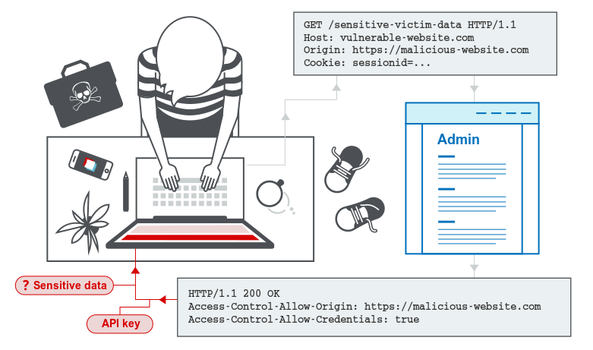
Cross-origin resource sharing (CORS)

Slide 12
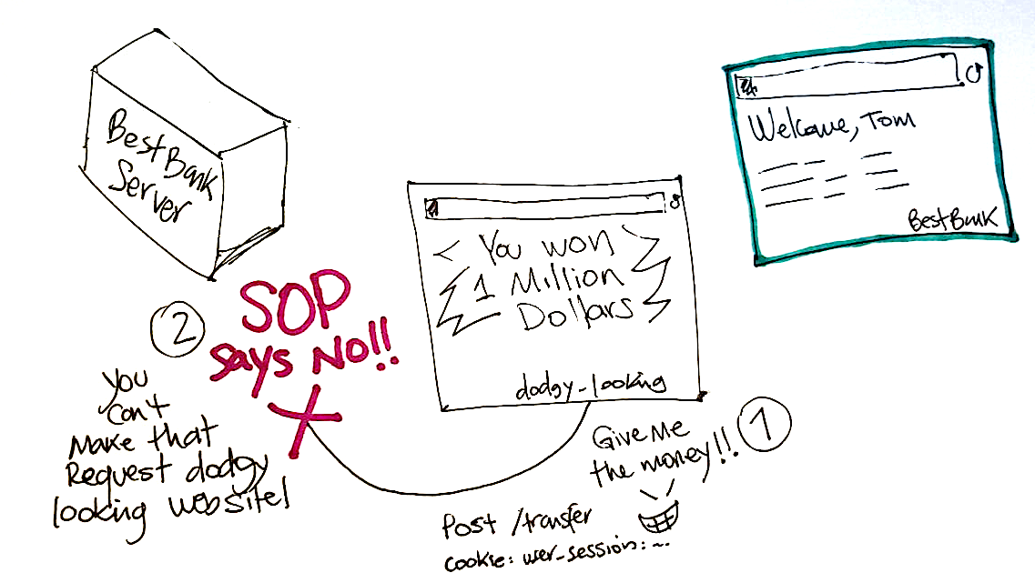
Same-origin policy (SOP)

Slide 13
Same-origin policy (SOP)
The same-origin policy is a web browser security mechanism that aims to prevent websites from attacking each other.
The same-origin policy restricts scripts on one origin from accessing data from another origin. An origin consists of a URI scheme, domain and port number. For example, consider the following URL:
http://normal-website.com/example/example.html
This uses the scheme http, the domain normal-website.com, and the port number 80.

Slide 14
Same-origin policy (SOP)
The following table shows how the same-origin policy will be applied if content at the above URL tries to access other origins:
URL accessed. | Access permitted?.
http://normal-website.com/example/ | Yes: same scheme, domain, and port
http://normal-website.com/example2/ | Yes: same scheme, domain, and port
https://normal-website.com/example/ | No: different scheme and port
http://en.normal-website.com/example/ | No: different domain
http://www.normal-website.com/example/ | No: different domain
http://normal-website.com:8080/example/ | No: different port*

Slide 15
Common Categories Of Vulnerability
Injection Attacks.
Broken authentication.
Information leakage.
Broken access controls.
Cross-site scripting.
Cross-site request forgery.

Slide 16
Injection Attacks
Injection flaws are very prevalent, particularly in legacy code. Injection vulnerabilities are often found in SQL, LDAP, XPath, or NoSQL queries, OS commands, XML parsers, SMTP headers, expression languages, and ORM queries.
Injection can result in data loss, corruption, or disclosure to unauthorized parties, loss of accountability, or denial of access. Injection can sometimes lead to complete host takeover. The business impact depends on the needs of the application and data.

Slide 17
SQL injection
SQL injection is a web security vulnerability that allows an attacker to interfere with the queries that an application makes to its database.
It generally allows an attacker to view data that they are not normally able to retrieve.
This might include data belonging to other users, or any other data that the application itself is able to access.
In many cases, an attacker can modify or delete this data, causing persistent changes to the application's content or behavior.
In some situations, an attacker can escalate an SQL injection attack to compromise the underlying server or other back-end infrastructure.

Slide 18
SQL injection
Types of SQL Injections
In-band SQLi
The attacker uses the same channel of communication to launch their attacks and to gather their results. In-band SQLi’s simplicity and efficiency make it one of the most common types of SQLi attack. There are two sub-variations of this method:
Error-based SQLi: the attacker performs actions that cause the database to produce error messages. The attacker can potentially use the data provided by these error messages to gather information about the structure of the database.
Union-based SQLi : this technique takes advantage of the UNION SQL operator, which fuses multiple select statements generated by the database to get a single HTTP response. This response may contain data that can be leveraged by the attacker.

Slide 19
SQL injection
Types of SQL Injections
Inferential (Blind) SQLi
The attacker sends data payloads to the server and observes the response and behavior of the server to learn more about its structure. This method is called blind SQLi because the data is not transferred from the website database to the attacker, thus the attacker cannot see information about the attack in-band.
Blind SQL injections can be classified as follows:
Boolean:that attacker sends a SQL query to the database prompting the application to return a result. The result will vary depending on whether the query is true or false. Based on the result, the information within the HTTP response will modify or stay unchanged. The attacker can then work out if the message generated a true or false result.
Time-based:attacker sends a SQL query to the database, which makes the database wait (for a period in seconds) before it can react. The attacker can see from the time the database takes to respond, whether a query is true or false. Based on the result, an HTTP response will be generated instantly or after a waiting period. The attacker can thus work out if the message they used returned true or false, without relying on data from the database.

Slide 20
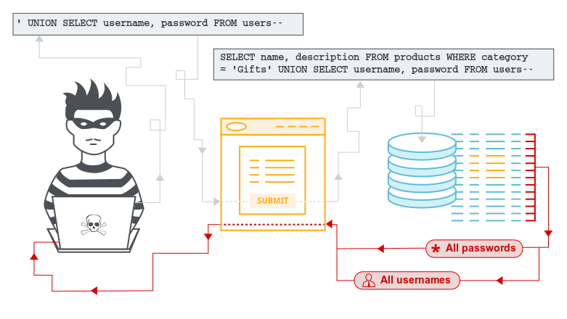
SQL injection

Slide 21
SQL injection
Example 1
In SQL:
select id, firstname, lastname from authors
If one provided:
Firstname: evil'ex
Lastname: Newman
the query string becomes:
select id, firstname, lastname from authors where forename = 'evil'ex' and surname='newman'
which the database attempts to run as:
Incorrect syntax near il' as the database tried to execute evil.

Slide 22
SQL injection
Example 1
A safe version of the above SQL statement could be coded in Java as:
String firstname = req.getParameter("firstname");
String lastname = req.getParameter("lastname");
// FIXME: do your own validation to detect attacks
String query = "SELECT id, firstname, lastname FROM authors WHERE forename = ? and surname = ?";
PreparedStatement pstmt = connection.prepareStatement( query );
pstmt.setString( 1, firstname );
pstmt.setString( 2, lastname );
try
{
ResultSet results = pstmt.execute( );
}

Slide 23
SQL injection
prevent SQL injection
Most instances of SQL injection can be prevented by using parameterized queries (also known as prepared statements) instead of string concatenation within the query.
Parameterized queries can be used for any situation where untrusted input appears as data within the query, including the WHERE clause and values in an INSERT or UPDATE statement.
They can't be used to handle untrusted input in other parts of the query, such as table or column names, or the ORDER BY clause.
For a parameterized query to be effective in preventing SQL injection, the string that is used in the query must always be a hard-coded constant, and must never contain any variable data from any origin

Slide 24
OS command injection
OS command injection (also known as shell injection) is a web security vulnerability that allows an attacker to execute arbitrary operating system (OS) commands on the server that is running an application, and typically fully compromise the application and all its data.
an attacker can leverage an OS command injection vulnerability to compromise other parts of the hosting infrastructure, exploiting trust relationships to pivot the attack to other systems within the organization.

Slide 25
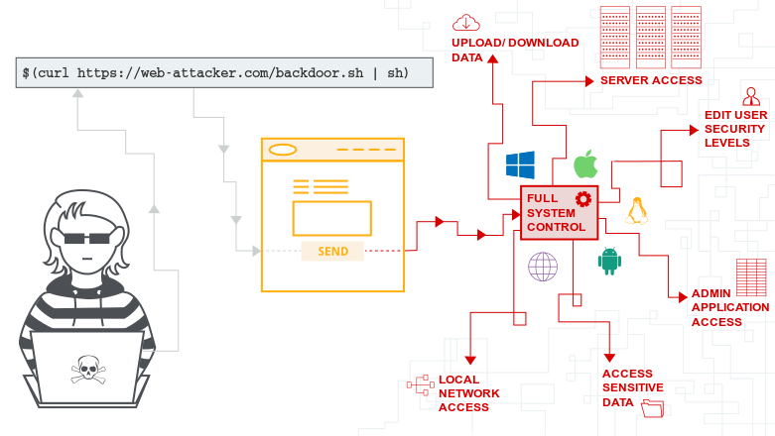
OS command injection

Slide 26
OS command injection
Executing arbitrary commands
Imagine a vulnerable application that has a common function that passes an IP address from a user input to the system's ping command. Therefore if the user input is 127.0.0.1, the following command is executed on the host operating system:
The attacker can then use this functionality to execute his own arbitrary commands. An example of adding additional system commands could look like this:
ping -c 5 127.0.0.1
ping -c 5 127.0.0.1; id

Slide 27
OS command injection
Executing arbitrary commands
first the ping command is executed and directly after that the id command execution takes place. Therefore the command output on the page will look like this:
PING 127.0.0.1 (127.0.0.1) 56(84) bytes of data.
64 bytes from 127.0.0.1: icmp_seq=1 ttl=64 time=0.023 ms
64 bytes from 127.0.0.1: icmp_seq=2 ttl=64 time=0.074 ms
64 bytes from 127.0.0.1: icmp_seq=3 ttl=64 time=0.074 ms
64 bytes from 127.0.0.1: icmp_seq=4 ttl=64 time=0.072 ms
64 bytes from 127.0.0.1: icmp_seq=5 ttl=64 time=0.037 ms
--- 127.0.0.1 ping statistics ---
5 packets transmitted, 5 received, 0% packet loss, time 3999ms
rtt min/avg/max/mdev = 0.023/0.056/0.074/0.021 ms
uid=0(root) gid=0(root) groups=0(root)

Slide 28
OS command injection
how to prevent command injection attack
If it is considered unavoidable to call out to OS commands with user-supplied input, then strong input validation must be performed. Some examples of effective validation include:
Validating against a whitelist of permitted values.
Validating that the input is a number.
Validating that the input contains only alphanumeric characters, no other syntax or whitespace.

Slide 29
Broken authentication
These types of weaknesses can allow an attacker to either capture or bypass the authentication methods that are used by a web application.
Permits automated attacks such as credential stuffing, where the attacker has a list of valid usernames and passwords.
Permits brute force or other automated attacks.
Permits default, weak, or well-known passwords, such as "Password1" or "admin/admin“.
Uses weak or ineffective credential recovery and forgot-password processes, such as "knowledge-based answers", which cannot be made safe.
Uses plain text, encrypted, or weakly hashed passwords (see A3:2017-Sensitive Data Exposure).
Has missing or ineffective multi-factor authentication.

Slide 30
Broken authentication
Exposes Session IDs in the URL (e.g., URL rewriting).
Does not rotate Session IDs after successful login.
Does not properly invalidate Session IDs. User sessions or authentication tokens (particularly single sign-on (SSO) tokens) aren't properly invalidated during logout or a period of inactivity.
The goal of an attack is to take over one or more accounts and for the attacker to get the same privileges as the attacked user.

Slide 31
Broken authentication
Risks
Credential stuffing
The use of lists of known passwords, is a common attack. If an application does not implement automated threat or credential stuffing protections, the application can be used as a password oracle to determine if the credentials are valid.
Application session timeouts aren't set properly
A user uses a public computer to access an application. Instead of selecting “logout” the user simply closes the browser tab and walks away. An attacker uses the same browser an hour later, and the user is still authenticated.

Slide 32
Broken authentication
Risks
Passwords are not properly hashed and salted
An insider or external attacker gains access to the system’s password database. User passwords are not properly hashed and salted, exposing every user’s password.

Slide 33
Broken authentication
How to Prevent
Where possible, implement multi-factor authentication to prevent automated, credential stuffing, brute force, and stolen credential re-use attacks.
Do not ship or deploy with any default credentials, particularly for admin users.
Implement weak-password checks, such as testing new or changed passwords against a list of the top 10000 worst passwords.
Align password length, complexity and rotation policies with NIST 800-63 B’s guidelines in section 5.1.1 for Memorized Secrets or other modern, evidence based password policies.
Ensure registration, credential recovery, and API pathways are hardened against account enumeration attacks by using the same messages for all outcomes.

Slide 34
Broken authentication
How to Prevent
Limit or increasingly delay failed login attempts. Log all failures and alert administrators when credential stuffing, brute force, or other attacks are detected.
Use a server-side, secure, built-in session manager that generates a new random session ID with high entropy after login. Session IDs should not be in the URL, be securely stored and invalidated after logout, idle, and absolute timeouts.

Slide 35
Information leakage
Information disclosure is when an application fails to properly protect sensitive and confidential information from parties that are not supposed to have access to the subject matter in normal circumstances. This allows malicious hackers to gather relevant information which can be used later in the attack lifecycle

Slide 36
Information leakage
Different Types of Information Disclosure
Banner Grabbing/Active Reconnaissance:
Banner grabbing or active reconnaissance is a type of attack during which the attackers send requests to the system they are attempting to attack in order to gather more information about it.
it may leak information about itself, such as the server version, PHP/ASP.NET version, OpenSSH version, etc.

Slide 37
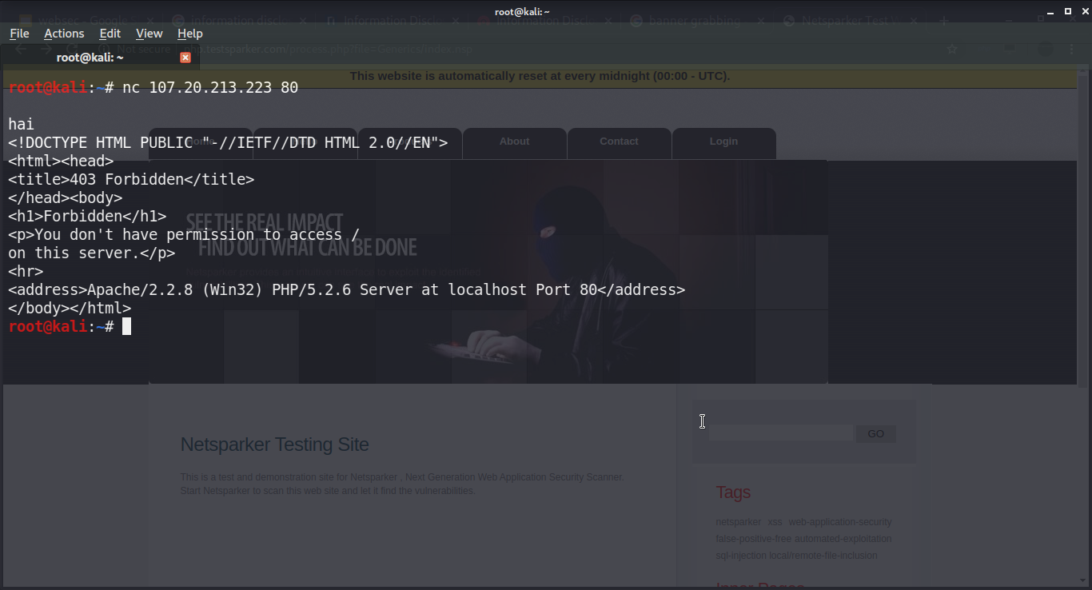
Information leakage
Different Types of Information Disclosure
Banner Grabbing/Active Reconnaissance:

Slide 38
Information leakage
Different Types of Information Disclosure
Source Code Disclosure
Source code disclosure issues occur when the code of the backend environment of a web application is exposed to the public. Source code disclosure enables attackers to understand how the application behaves by simply reading the code and checking for logical flaws, or hardcoded username/password pairs, or API secret keys.
In short, source code disclosure turns a black box testing process into more of a white box testing approach since attackers get access to the code.

Slide 39
Information leakage
Different Types of Information Disclosure
Inappropriate Handling of Sensitive Data
Another common mistake is hardcoding important information such as username/password pairs, internal IP addresses in scripts and comments in code and web pages. In most cases such information is released on the production web application . The disclosure of such information may cause ravaging outcomes for the web application; all the attacker has to do is to look for such information in the source of those web pages.

Slide 40
Information leakage
Mitigation Against Disclosure of Information
Make sure that your web server does not send out response headers or background information that reveal technical details about the backend technology type, version or setup.
Make sure that all the services running on the server’s open ports do not reveal information about their builds and versions.
Always make sure that proper access controls and authorizations are in place in order to disallow access for attackers on all web servers, services and web applications.
Make sure that all exceptions are well handled when the web application fails and no technical information is reported in the errors.

Slide 41
Information leakage
Mitigation Against Disclosure of Information
Do not hard code credentials, API keys, IP addresses, or any other sensitive information in the code, including first names and last names, not even in the form of comments.
Configure the correct MIME types on your web server for all the different files being used in your web applications.
Sensitive data, files and any other item of information that do not need to be on the web servers should never be uploaded on the web server.
Always check whether each of the requests to create/edit/view/delete resources has proper access controls, preventing privilege escalation issues and making sure that all the confidential information remains confidential.

Slide 42
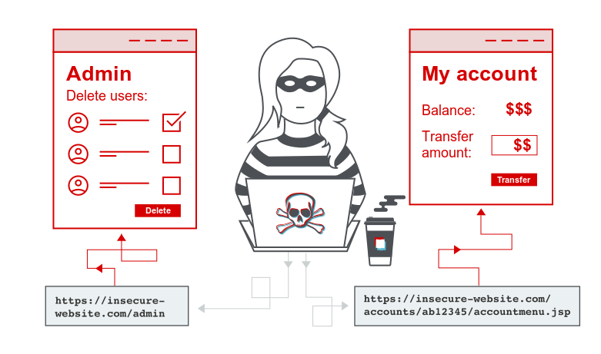
Broken access controls.
Access control enforces policy such that users cannot act outside of their intended permissions. Failures typically lead to unauthorized information disclosure, modification or destruction of all data, or performing a business function outside of the limits of the user.

Slide 43
Broken access controls.
Common access control vulnerabilities
Bypassing access control checks by modifying the URL, internal application state, or the HTML page, or simply using a custom API attack tool.
Allowing the primary key to be changed to another's users record, permitting viewing or editing someone else's account.
Allowing the primary key to be changed to another's users record, permitting viewing or editing someone else's account.
Elevation of privilege. Acting as a user without being logged in, or acting as an admin when logged in as a user.

Slide 44
Broken access controls.
Common access control vulnerabilities
Metadata manipulation, such as replaying or tampering with a JSON Web Token (JWT) access control token or a cookie or hidden field manipulated to elevate privileges, or abusing JWT invalidation.
CORS misconfiguration allows unauthorized API access.
Force browsing to authenticated pages as an unauthenticated user or to privileged pages as a standard user. Accessing API with missing access controls for POST, PUT and DELETE.

Slide 45
Broken access controls.
BROKEN ACCESS CONTROL EXAMPLES
The application uses unverified data
The application uses unverified data in a SQL call that is accessing account information:
An attacker simply modifies the acct parameter in the browser to send whatever account number they want. If not properly verified, the attacker can access any user's account.
pstmt.setString(1, request.getParameter("acct"));
ResultSet results = pstmt.executeQuery();
http://example.com/app/accountInfo?acct=notmyacct

Slide 46
Broken access controls.
BROKEN ACCESS CONTROL EXAMPLES
An attacker simply force browser to target URLs
Admin rights are required for access to the admin page.
If an unauthenticated user can access either page, it’s a flaw. If a non-admin can access the admin page, this is a flaw.
http://example.com/app/getappInfo
http://example.com/app/admin_getappInfo

Slide 47
Broken access controls.
Protect Yourself
Insecure Id’s – Most web sites use some form of id, key, or index as a way to reference users, roles, content, objects, or functions. If an attacker can guess these id’s, and the supplied values are not validated to ensure the are authorized for the current user, the attacker can exercise the access control scheme freely to see what they can access. Web applications should not rely on the secrecy of any id’s for protection.
Forced Browsing Past Access Control Checks – many sites require users to pass certain checks before being granted access to certain URLs that are typically ‘deeper’ down in the site. These checks must not be bypassable by a user that simply skips over the page with the security check.

Slide 48
Broken access controls.
Protect Yourself
Path Traversal – This attack involves providing relative path information (e.g., “../../target_dir/target_file”) as part of a request for information. Such attacks try to access files that are normally not directly accessible by anyone, or would otherwise be denied if requested directly. Such attacks can be submitted in URLs as well as any other input that ultimately accesses a file (i.e., system calls and shell commands).
Client Side Caching – Many users access web applications from shared computers located in libraries, schools, airports, and other public access points. Browsers frequently cache web pages that can be accessed by attackers to gain access to otherwise inaccessible parts of sites. Developers should use multiple mechanisms, including HTTP headers and meta tags, to be sure that pages containing sensitive information are not cached by user’s browsers.

Slide 49
Broken access controls.
Protect Yourself
File Permissions – Many web and application servers rely on access control lists provided by the file system of the underlying platform. Even if almost all data is stored on backend servers, there are always files stored locally on the web and application server that should not be publicly accessible, particularly configuration files, default files, and scripts that are installed on most web and application servers. Only files that are specifically intended to be presented to web users should be marked as readable using the OS’s permissions mechanism, most directories should not be readable, and very few files, if any, should be marked executable.

Slide 50
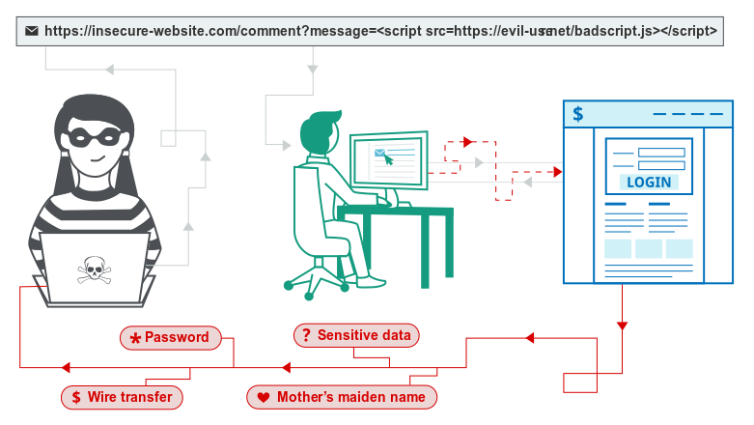
Cross-site scripting.

Slide 51
Cross-site scripting.
Cross-site Scripting (XSS) is a client-side code injection attack. The attacker aims to execute malicious scripts in a web browser of the victim by including malicious code in a legitimate web page or web application. The actual attack occurs when the victim visits the web page or web application that executes the malicious code. The web page or web application becomes a vehicle to deliver the malicious script to the user’s browser.
An attacker can use XSS to send a malicious script to an unsuspecting user. The end user’s browser has no way to know that the script should not be trusted, and will execute the script. Because it thinks the script came from a trusted source, the malicious script can access any cookies, session tokens, or other sensitive information retained by the browser and used with that site. These scripts can even rewrite the content of the HTML page.

Slide 52
Cross-site scripting.
What are the types of XSS attacks?
Reflected XSS, where the malicious script comes from the current HTTP request.
Stored XSS, where the malicious script comes from the website's database.
DOM-based XSS, where the vulnerability exists in client-side code rather than server-side code.

Slide 53
Cross-site scripting.
Reflected cross-site scripting
Reflected XSS is the simplest variety of cross-site scripting. It arises when an application receives data in an HTTP request and includes that data within the immediate response in an unsafe way.
Here is a simple example of a reflected XSS vulnerability:
https://insecure-website.com/status?message=All+is+well.
<p>Status: All is well.</p>
The application doesn't perform any other processing of the data, so an attacker can easily construct an attack like this:
https://insecure-website.com/status?message=<script>/*+Bad+stuff+here...+*/</script>
<p>Status: <script>/* Bad stuff here... */</script></p>

Slide 54
Cross-site scripting.
Reflected cross-site scripting
If the user visits the URL constructed by the attacker, then the attacker's script executes in the user's browser, in the context of that user's session with the application. At that point, the script can carry out any action, and retrieve any data, to which the user has access.

Slide 55
Cross-site scripting.
Reflected cross-site scripting
If the user visits the URL constructed by the attacker, then the attacker's script executes in the user's browser, in the context of that user's session with the application. At that point, the script can carry out any action, and retrieve any data, to which the user has access.

Slide 56
Cross-site scripting.
Stored cross-site scripting
Stored XSS (also known as persistent or second-order XSS) arises when an application receives data from an untrusted source and includes that data within its later HTTP responses in an unsafe way.
The data in question might be submitted to the application via HTTP requests; for example, comments on a blog post, user nicknames in a chat room, or contact details on a customer order. In other cases, the data might arrive from other untrusted sources; for example, a webmail application displaying messages received over SMTP, a marketing application displaying social media posts, or a network monitoring application displaying packet data from network traffic.

Slide 57
Cross-site scripting.
Stored cross-site scripting
Here is a simple example of a stored XSS vulnerability. A message board application lets users submit messages, which are displayed to other users:
<p>Hello, this is my message!</p>
The application doesn't perform any other processing of the data, so an attacker can easily send a message that attacks other users:
<p><script>/* Bad stuff here... */</script></p>

Slide 58
Cross-site scripting.
DOM-based cross-site scripting
DOM-based XSS (also known as DOM XSS) arises when an application contains some client-side JavaScript that processes data from an untrusted source in an unsafe way, usually by writing the data back to the DOM.
In the following example, an application uses some JavaScript to read the value from an input field and write that value to an element within the HTML.
var search = document.getElementById('search').value;
var results = document.getElementById('results');
results.innerHTML = 'You searched for: ' + search;
If the attacker can control the value of the input field, they can easily construct a malicious value that causes their own script to execute:
You searched for: <img src=1 onerror='/* Bad stuff here... */'>

Slide 59
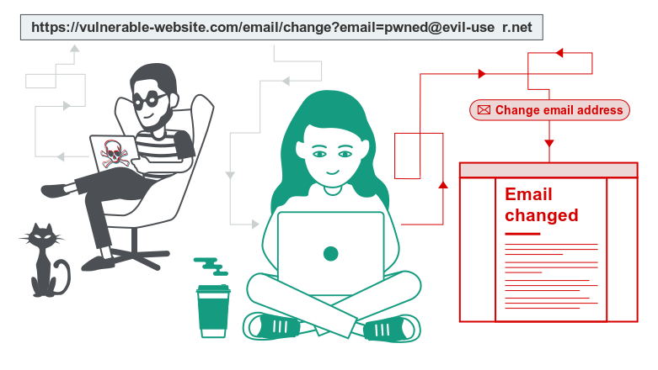
Cross-site request forgery (CSRF)
Cross-site request forgery (also known as CSRF) is a web security vulnerability that allows an attacker to induce users to perform actions that they do not intend to perform. It allows an attacker to partly circumvent the same origin policy, which is designed to prevent different websites from interfering with each other.

Slide 60
Cross-site request forgery (CSRF)
impact of a CSRF attack
In a successful CSRF attack, the attacker causes the victim user to carry out an action unintentionally. For example, this might be to change the email address on their account, to change their password, or to make a funds transfer. Depending on the nature of the action, the attacker might be able to gain full control over the user's account. If the compromised user has a privileged role within the application, then the attacker might be able to take full control of all the application's data and functionality.

Slide 61
Cross-site request forgery (CSRF)
impact of a CSRF attack
In a successful CSRF attack, the attacker causes the victim user to carry out an action unintentionally. For example, this might be to change the email address on their account, to change their password, or to make a funds transfer. Depending on the nature of the action, the attacker might be able to gain full control over the user's account. If the compromised user has a privileged role within the application, then the attacker might be able to take full control of all the application's data and functionality.

Slide 62
Cross-site request forgery (CSRF)
How does CSRF work?
For a CSRF attack to be possible, three key conditions must be in place:
A relevant action. There is an action within the application that the attacker has a reason to induce. This might be a privileged action (such as modifying permissions for other users) or any action on user-specific data (such as changing the user's own password).
Cookie-based session handling. Performing the action involves issuing one or more HTTP requests, and the application relies solely on session cookies to identify the user who has made the requests. There is no other mechanism in place for tracking sessions or validating user requests.
No unpredictable request parameters. The requests that perform the action do not contain any parameters whose values the attacker cannot determine or guess. For example, when causing a user to change their password, the function is not vulnerable if an attacker needs to know the value of the existing password.

Slide 63
Cross-site request forgery (CSRF)
How does CSRF work?
For a CSRF attack to be possible, three key conditions must be in place:
A relevant action. There is an action within the application that the attacker has a reason to induce. This might be a privileged action (such as modifying permissions for other users) or any action on user-specific data (such as changing the user's own password).
Cookie-based session handling. Performing the action involves issuing one or more HTTP requests, and the application relies solely on session cookies to identify the user who has made the requests. There is no other mechanism in place for tracking sessions or validating user requests.
No unpredictable request parameters. The requests that perform the action do not contain any parameters whose values the attacker cannot determine or guess. For example, when causing a user to change their password, the function is not vulnerable if an attacker needs to know the value of the existing password.

Slide 64
Cross-site request forgery (CSRF)
How does CSRF work?
With these conditions in place, the attacker can construct a web page containing the following HTML:
<html>
<body>
<form action="https://vulnerable-website.com/email/change" method="POST">
<input type="hidden" name="email" value="pwned@evil-user.net" />
</form>
<script>
document.forms[0].submit();
</script>
</body>
</html>

Slide 65
Cross-site request forgery (CSRF)
How does CSRF work?
If a victim user visits the attacker's web page, the following will happen:
The attacker's page will trigger an HTTP request to the vulnerable web site.
If the user is logged in to the vulnerable web site, their browser will automatically include their session cookie in the request (assuming SameSite cookies are not being used).
The vulnerable web site will process the request in the normal way, treat it as having been made by the victim user, and change their email address.

Slide 66
Cross-site request forgery (CSRF)
Preventing CSRF attacks
The most robust way to defend against CSRF attacks is to include a CSRF token within relevant requests. The token should be:
Unpredictable with high entropy, as for session tokens in general.
Tied to the user's session.
Strictly validated in every case before the relevant action is executed.

Slide 67

THANK YOU

